Slide 1

Software Tester
Level 4
Module of Study: Build and Test Software
Learning Outcomes/Objectives Addressed

Slide 2
Learning objectives (1/2)
Python:
Process booleans in Python
Obtain and process user input
Use methods to process lists in Python
Process JSON format results from an API call, creating code to provide a price alert

Slide 3
Learning Objectives (2/2)
Version Control Systems and GitHub:
Recognise the range of VCSs on the market
Understand Git and GitHub
Create a GitHub account
Follow others on GitHub and explore resources available
Set up a project and add collaborators on GitHub
Add a repository
Update and share projects

Slide 4
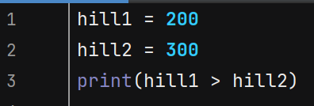
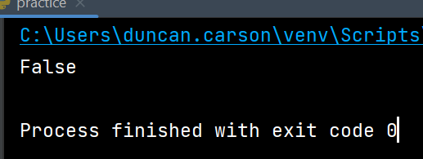
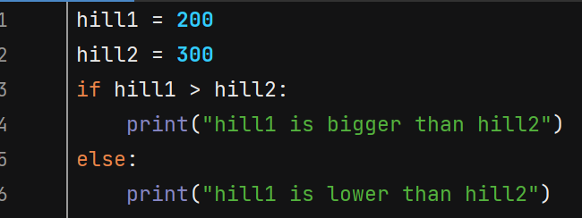
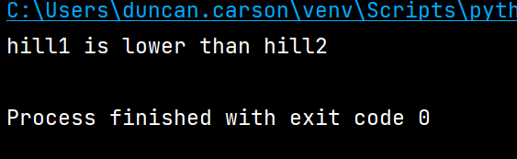
Booleans
True or false.
Python can evaluate statements and provide a true or false response.
If statements are commonly used to evaluate conditions and actions are performed based on whether the result if true or false.

Slide 5
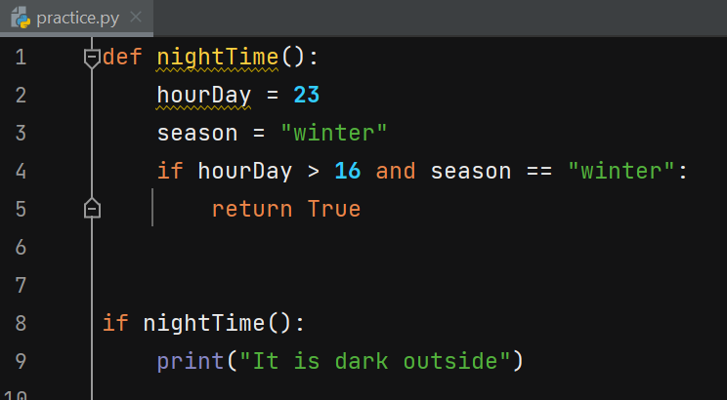
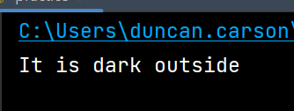
Functions can return a Boolean
Example:

Slide 6
Booleans exercise
What result would this return?
print(10>20)
Change the code of the nightTime() function so that it prints an alternative message when it is spring and 18 hours.

Slide 7

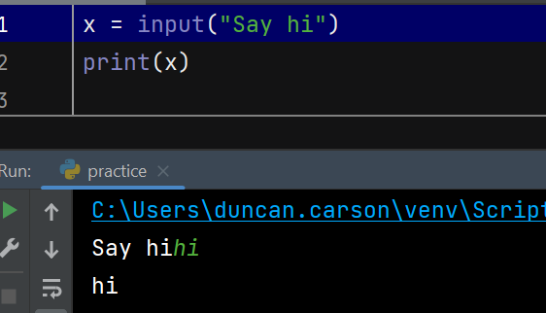
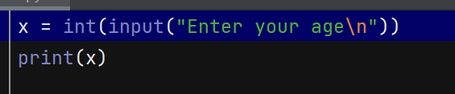
Obtain user input
To obtain input from the user we can use the input() function:
If we want to assign that input to a variable we can do this:
We may want to make sure the user input is treated as a certain data type.
How do we do that?
Like this:
What happens if you enter text?

Slide 8
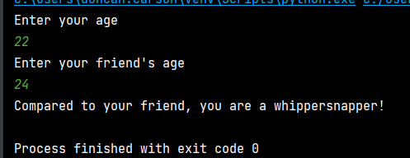
User input and Booleans exercise
Write some code to ask the user their age and also the age of a friend.
Assign these values to integer variables.
Declare a Boolean variable friend_older which is a result of the comparison between your age and your friend’s age.
Print out an amusing message related to your/your friend’s age.
Example:

Slide 9
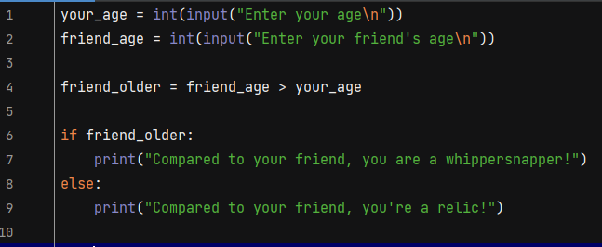
Booleans exercise solution
Notes:
your_age = int(input("Enter your age\n")) friend_age = int(input("Enter your friend's age\n")) friend_older = friend_age > your_age if friend_older: print("Compared to your friend, you are a whippersnapper!") else: print("Compared to your friend, you're a relic!")

Slide 10
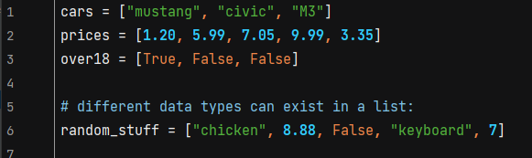
Python Lists
Store a collection of data (multiple items) in a single variable.
A defined order that will not change.
A list is changeable. We can add, change and remove items after the list has been created.
Lists allow duplicate values in the list (because they are indexed).
Lists are in square backets.

Slide 11
Python lists task
Create a list called numbers that contains the following integers: 1, 2, 3, 4, 5
Use the len function to find the length of the numbers list
Use the sum function to find the sum of the numbers in the numbers list
Use the max function to find the maximum number in the numbers list
Use the min function to find the minimum number in the numbers list
Use indexing to access the third element in the numbers list and assign it to a variable called third
Use slicing to create a new list called first_three that contains the first three elements of the numbers list
Use the append method to add the integer 6 to the numbers list
Use the insert method to insert the integer 0 at the beginning of the numbers list
Use the remove method to remove the integer 2 from the numbers list

Slide 12
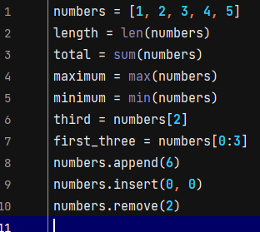
Python lists solution
Notes:
numbers = [1, 2, 3, 4, 5] length = len(numbers) total = sum(numbers) maximum = max(numbers) minimum = min(numbers) third = numbers[2] first_three = numbers[0:3] numbers.append(6) numbers.insert(0, 0) numbers.remove(2)

Slide 13
Python lists – sort() task
Find out how to sort lists.
Practice using the sort() function on lists of integers and lists of strings:
Create a list of integers called numbers with the following values: [3, 4, 2, 1, 5]
Create a list of strings called words with the following values: ['cat', 'dog', 'bird', 'ant', 'elephant']
Use the sort() method to sort the numbers list in ascending order
Use the sort() method to sort the words list in ascending order
Print the sorted numbers and words lists to verify that they are correctly sorted
Now sort them in reverse order.

Slide 14
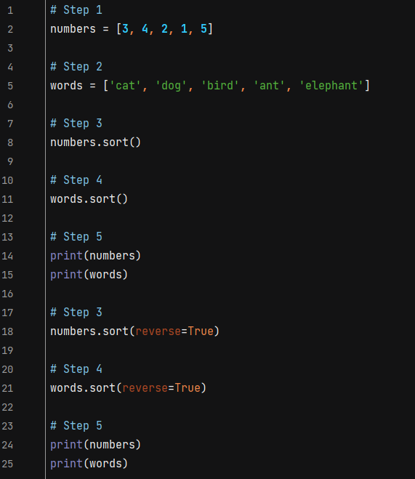
Solution : Python lists – sort() task
Notes:
# Step 1 numbers = [3, 4, 2, 1, 5] # Step 2 words = ['cat', 'dog', 'bird', 'ant', 'elephant'] # Step 3 numbers.sort() # Step 4 words.sort() # Step 5 print(numbers) print(words) # Step 3 numbers.sort(reverse=True) # Step 4 words.sort(reverse=True) # Step 5 print(numbers) print(words)

Slide 15
List Sort() exercise
Create a list of strings called words with the following values: ['cat', 'Dog', 'BIRD', 'ant', 'Elephant']
Use the sort() function to sort the words list in ascending order, ignoring case
Print the sorted words list to verify that it is correctly sorted

Slide 16
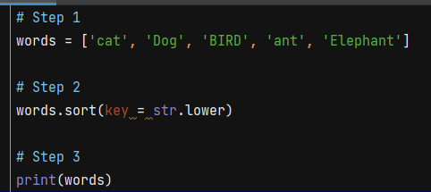
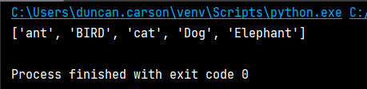
List Sort() exercise solution
Notes:
# Step 1 words = ['cat', 'Dog', 'BIRD', 'ant', 'Elephant'] # Step 2 words.sort(key = str.lower) # Step 3 print(words)
You can customize your own function by using the keyword argument key = function.

Slide 17
Practical API coding task
What is an API?

Slide 18
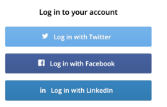
API
API stands for application programming interface.
Allows users to access organisation’s data securely.
Examples:
Weather on an app – provided by an API.
Login using Twitter, Google etc. – Login is authenticated with Twitter/Google API etc
APIs that access finance platform data for tax calculations

Slide 19
JSON
JSON stands for JavaScript Object Notation.
Used to store and transport data – eg send data from server to a webpage – or exchange API data.
What are the JSON syntax rules?
Data is in name/value pairs.
Data is separated by commas
Objects are held in curly braces
Square brackets hold arrays.
Employee object example:
{ "employees":[ {"firstName":"John", "lastName":"Doe"}, {"firstName":"Anna", "lastName":"Smith"}, {"firstName":"Peter", "lastName":"Jones"} ] }

Slide 20
Code example – Bitcoin price alerts
Get price of Bitcoin and display as an alert periodically
We will user the API of Coingecko.
This provides a wide range of data on nearly all cryptocurrencies.
https://www.coingecko.com/

Slide 21
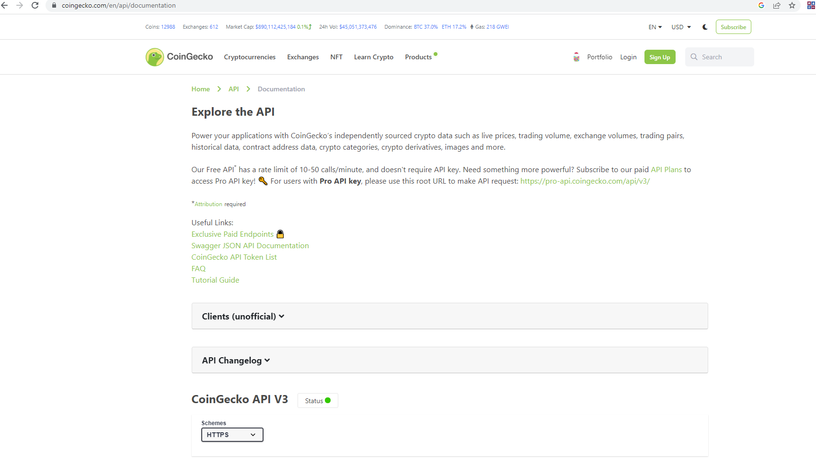
CoinGecko API documentation
https://www.coingecko.com/en/api/documentation

Slide 22
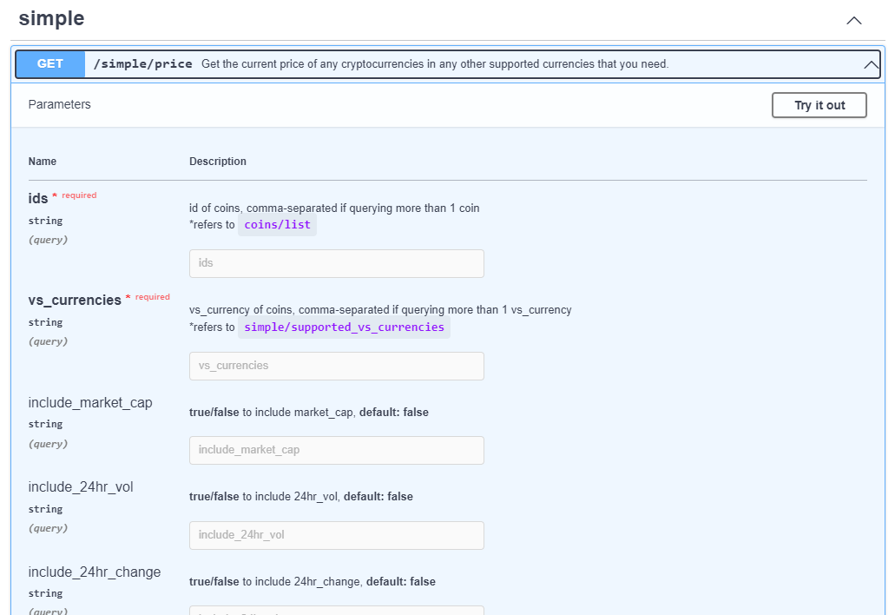
Get price
We will need to get the price.
Scroll down to Simple / price.
We click the Try it out button.
Only two parameters are required:
ids, vs_currency
Note: if you look at coins/list further down you can see it is all the supported crypto and fiat currencies.
Notes:
Note you need to clnick “execute” butt

Slide 23
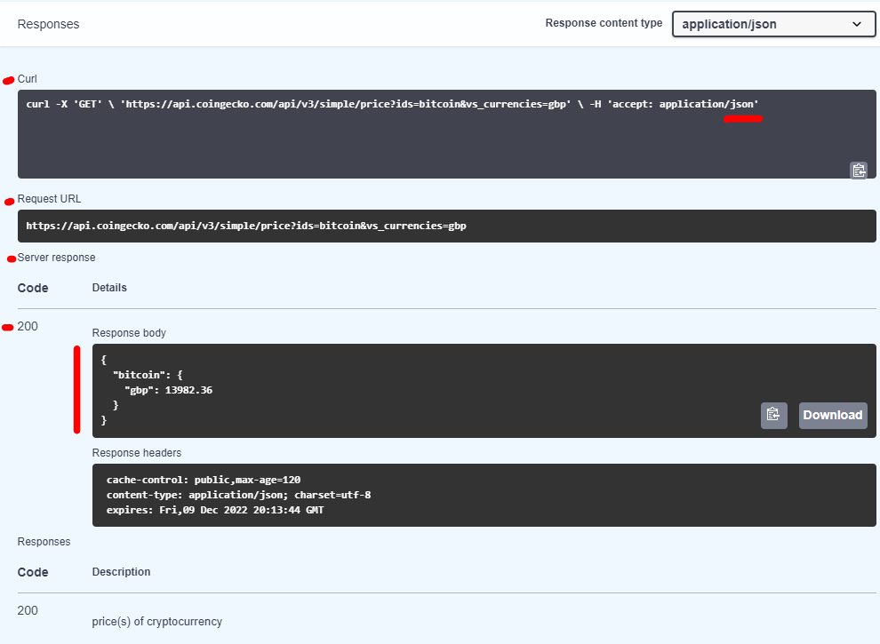
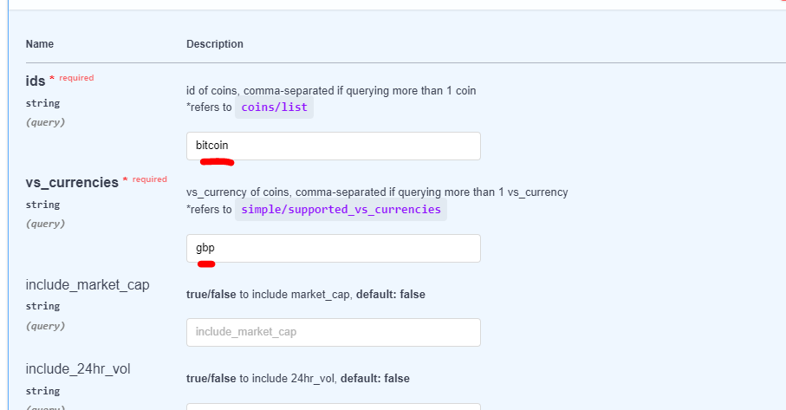
Output
We compare Bitcoin to GBP.
Response:
Notes:
CURL – client URL
200 is the http OK response code (ie successful request)
Note the JSON syntax of the response

Slide 24
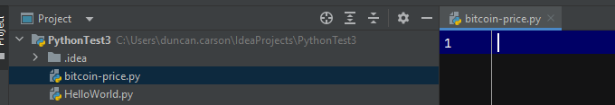
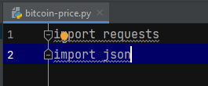

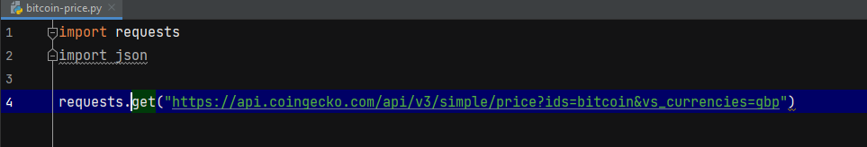
Our python file
New file – bitcoin-price.py
Import statements – may need to download requests (red bulb option)
requests.get – insert the request URL from CoinGecko

Slide 25
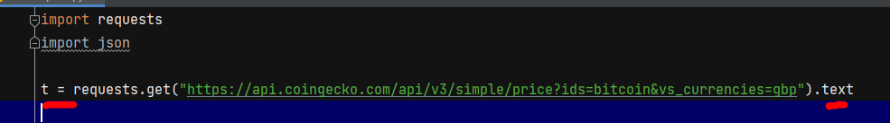
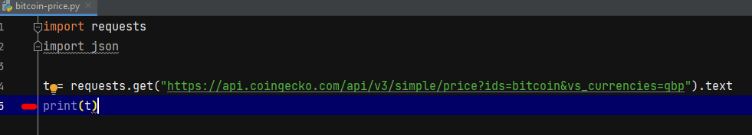
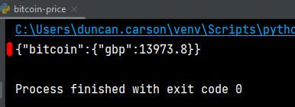
Working with the request
We want to work with the received response as text. We also assign it to a variable:
We can confirm that JSON is sent by CoinGecko by printing the value of t:

Slide 26
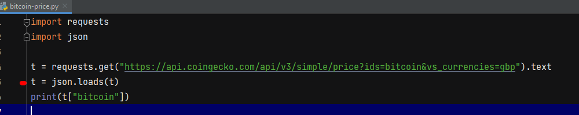

JSON loads
We need to use JSON.loads. Loads() method returns a Python dictionary (data type).
We assign the result of json.loads on our “t” variable to “t”.
Printing the data associated with bitcoin shows the associated name:value pair

Slide 27

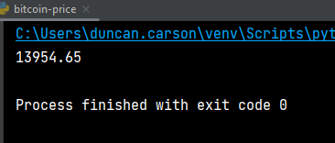
Extracting only the price
We want only the price, and we want to cast it to a string, (only necessary for the notification)
We check with a print statement that we just get the price:

Slide 28
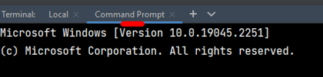
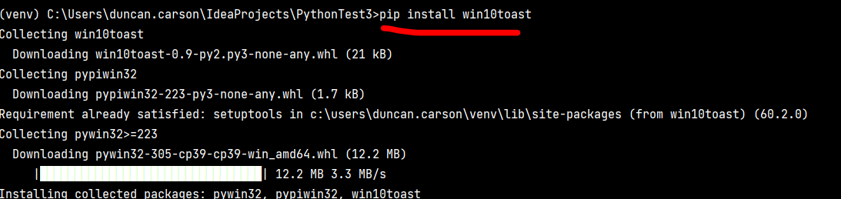
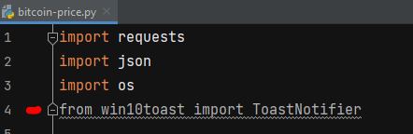
Win10toast module
The Win10toast module allows notifications.
Use the Command prompt
Install win10toast module:
In the Python file, import ToastNotifier (from win10toast):
Notes:
Note original version used os module and notify-send but that only works for Linux.
Win10toast enables you to post notifications in Windows.
Help on win10toast: https://stackoverflow.com/questions/12575708/notification-using-python

Slide 29
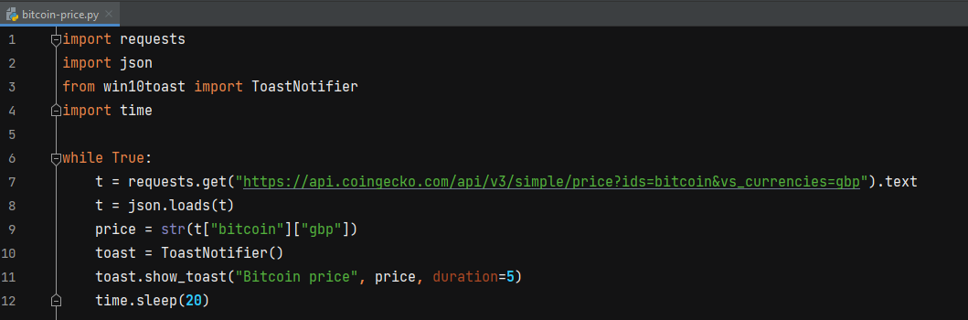
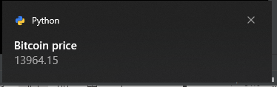
Final code
We include code in a loop and use the time module to repeat every 20 seconds (notification lasts 5 secs)

Slide 30
Tasks
Modify the code to repeat 3 times (instead of a while loop)

Slide 31
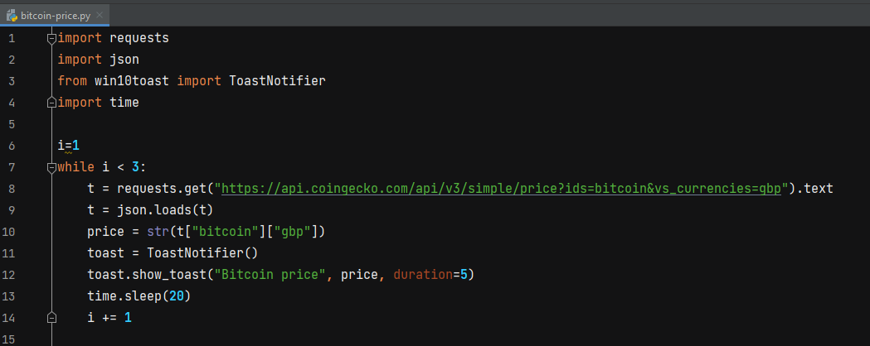
Task solution

Slide 32
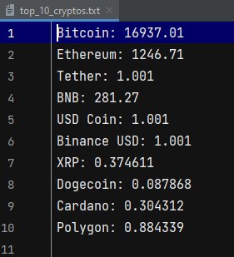
Additional possible task
Write python code to use Coin Gecko's API to get the prices of the current top 10 cryptocurrencies and create a text file containing the data.
Example file:

Slide 33
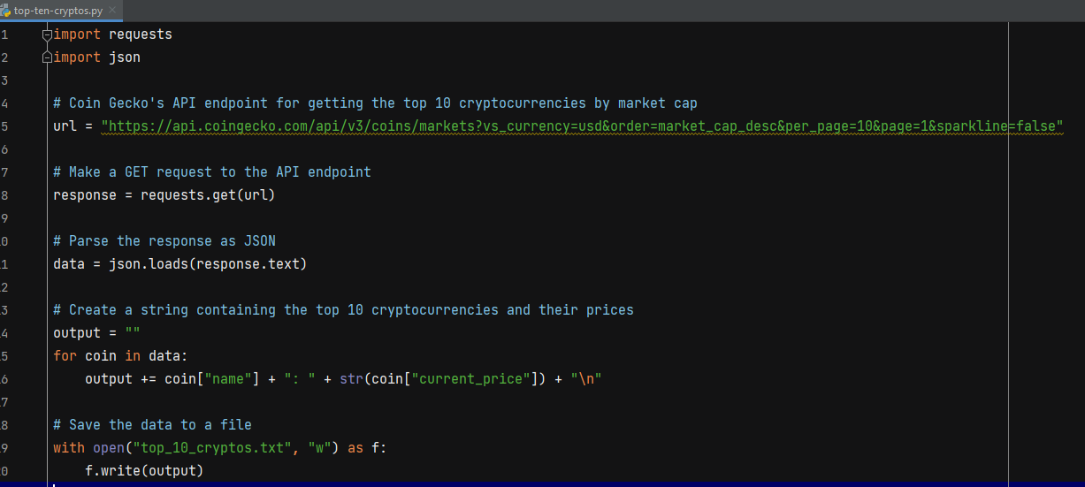
Solution
Notes:
import requests import json # Coin Gecko's API endpoint for getting the top 10 cryptocurrencies by market cap url = "https://api.coingecko.com/api/v3/coins/markets?vs_currency=usd&order=market_cap_desc&per_page=10&page=1&sparkline=false" # Make a GET request to the API endpoint response = requests.get(url) # Parse the response as JSON data = json.loads(response.text) # Create a string containing the top 10 cryptocurrencies and their prices output = "" for coin in data: output += coin["name"] + ": " + str(coin["current_price"]) + "\n" # Save the data to a file with open("top_10_cryptos.txt", "w") as f: f.write(output)

